Slide 1
The State of OSS and .NET
Jason Bock
Practice Lead

Slide 2

Let’s Just Talk About the Microsoft/GitHub Acquisition
Jason Bock
Practice Lead

Slide 3
Personal Info
http://www.magenic.com
http://www.jasonbock.net
https://www.twitter.com/jasonbock
https://www.github.com/jasonbock
jasonb@magenic.com

Slide 4
Downloads
https://github.com/JasonBock/StateOfOSSInDotNet
https://github.com/JasonBock/Presentations/blob/master/The%20State%20of%20OSS%20and%20.NET.pptx

Slide 5
Overview
History
Demo
Future Trends
Remember…
https://github.com/JasonBock/StateOfOSSInDotNet
https://github.com/JasonBock/Presentations/blob/master/The%20State%20of%20OSS%20and%20.NET.pptx

Slide 6

History
https://logos-download.com/wp-content/uploads/2016/02/Microsoft_logo.png
Notes:
Microsoft. It’s a company that’s been around since 1975, and it’s gone through a lot of change since its founding.

Slide 7

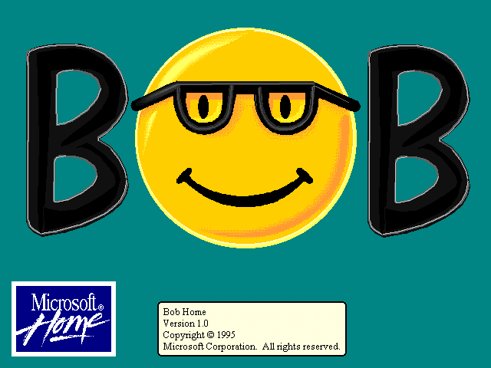
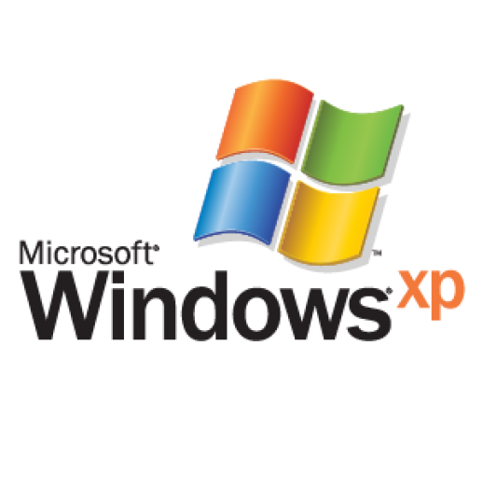


History
Micro$oft
https://static.businessinsider.com/image/555a17839d8e441f018b4581/image.gif
http://www.vectorsland.com/imgd/l4335-windows-xp-logo-95423.png
http://toastytech.com/guis/bobboot1.png
https://en.wikipedia.org/wiki/File:Microsoft-Sharp-Kin-Two-Phone-Open.jpg
Notes:
There’s still a percentage of folks that still view Microsoft like this.

Slide 8

History
"Linux is a cancer that attaches itself in an intellectual property sense to everything it touches."
http://4.bp.blogspot.com/-9qMHIubJrZs/Uhk0nSU7uiI/AAAAAAAAqec/GBebMxrRsjg/s1600/Steve+Ballmer+going+crazy+++YouTube.png
https://www.zdnet.com/article/ballmer-i-may-have-called-linux-a-cancer-but-now-i-love-it/
Notes:
Remember this quote from Ballmer: Linux is a cancer

Slide 9
History
On October 31, 1998, the first so-called "Halloween memo" from Microsoft suggested that some in the company saw open-source software as a major threat. "The intrinsic parallelism and free idea exchange in open-source software has benefits that are not replicable with our current licensing model and therefore present a long-term developer mindshare threat," the memo said, suggesting that one way to thwart open-source software would be to extend communication protocols with Microsoft-only changes.
https://www.cnet.com/news/microsofts-long-history-of-open-source-acrimony/
Notes:
And the Halloween document.

Slide 10
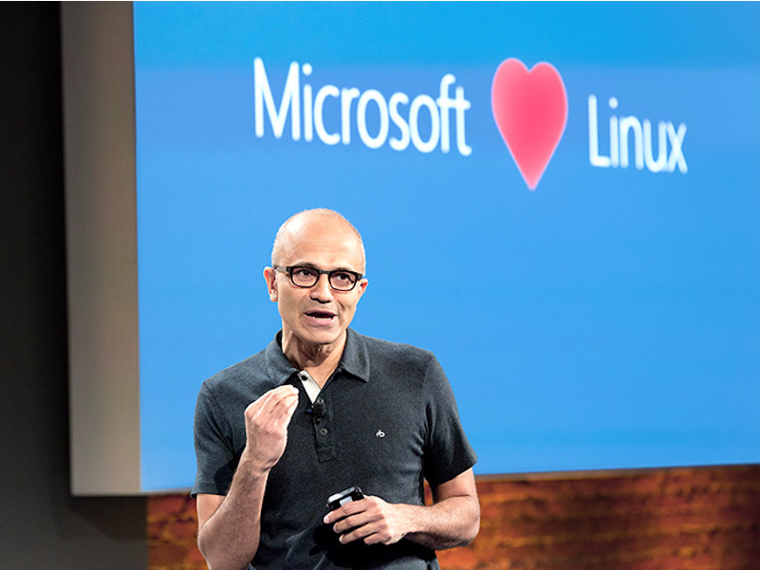
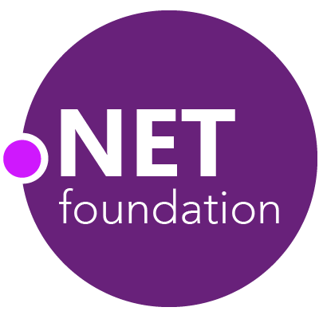
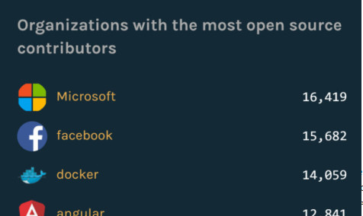
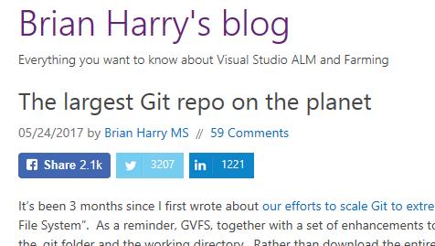
History
http://static5.businessinsider.com/image/56685d0684307626008b8b6b-801/microsoft_loves_linux.jpg
http://www.dotnetfoundation.org/
https://blogs.msdn.microsoft.com/bharry/2017/05/24/the-largest-git-repo-on-the-planet/
https://verdict4u.files.wordpress.com/2016/09/microsoft-tops-githubs-list-of-orgs-with-open-source-contributors.jpg?w=474
Notes:
So how did we get from there to here?
Satya: Microsoft loves Linux
.NET Foundation
Microsoft puts Windows in Git
Microsoft biggest contributor in GitHub
This is a radically different world!

Slide 11



History
https://upload.wikimedia.org/wikipedia/en/thumb/6/60/Microsoft_logo_%281975%29.svg/1024px-Microsoft_logo_%281975%29.svg.png
http://diylogodesigns.com/blog/wp-content/uploads/2016/04/Microsoft-Logo-icon-png-Transparent-Background.png
https://docs.microsoft.com/en-us/dotnet/images/hub/net.svg
Notes:
So how did we get from A to B? And specifically, how did we get here with a specific look at how .NET came about, and how it went to becoming open source.

Slide 12

History
http://www.telecommandercorp.com/ebaylinks/Microsoft/visualj++1.1proretail/j++sm.jpg
Notes:
Let’s start with Visual J++, which was released in 1996 (or 1997?). But….there were problems:
While J++ conformed to the Java language specification, Microsoft did not implement certain features of the official Sun Java implementation in its Visual J++ product line. Remote Method Invocation (Java RMI) and Java Native Interface (JNI) are such examples.
In addition, J++ implemented other extensions that were not part of Sun's Java implementation. The inclusion of callbacks and delegates for event handling further contributed to defining J++ as a completely different language merely based on an already existing design concept.
Furthermore, J++ applications did not conform to the standardized method of accessing the underlying operating system functions as any other Java application under Sun's Java SDK.
This led to a lawsuit between MS and Sun, which MS lost. However, rather than continue working on their JVM, they decided to roll their own.

Slide 13
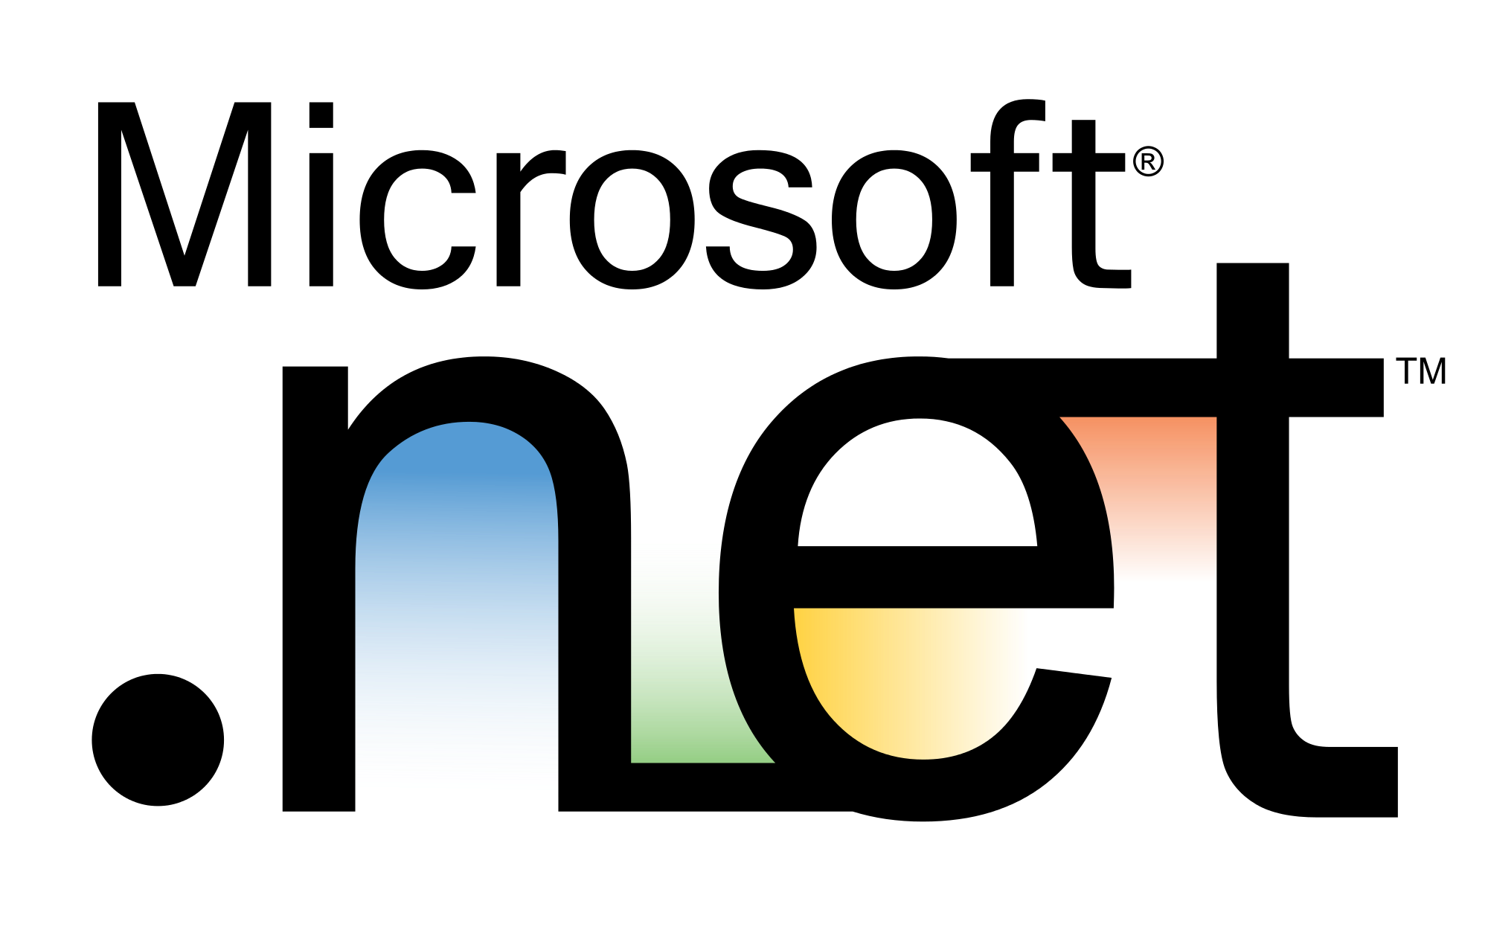
History
http://www.omshantiinfotech.com/img/Microsoft-window.png
Notes:
In 2002, Micorosft released the first version of .NET. At this time, nothing was open-source.

Slide 14

History
Microsoft has built the Shared Source CLI so that researchers, students, professors and other interested developers can teach, learn, and experiment with advanced computer language infrastructure. To achieve this goal, the source code to both the Windows XP and FreeBSD versions of the software has been released using the shared source approach to source code access. The license for the Shared Source CLI Implementation permits anyone to use or modify its code for non-commercial purposes.
https://covers.oreillystatic.com/images/9780596003517/lrg.jpg
https://msdn.microsoft.com/en-us/library/ms973879.aspx
Notes:
There was the Shared Source CLI, also called Rotor, with its “shared source approach”: “This license allows modifications and redistribution of the code for personal or academic usages, but they can't be used for commercial products.”

Slide 15

History
https://luauf.com/wp-content/uploads/2008/05/mono-logo.png
Notes:
There was (and is!) also Mono, which was an open source implementation. The vast majority of .NET developers didn’t target this, but it was another option, and it let devs target other OSes.

Slide 16
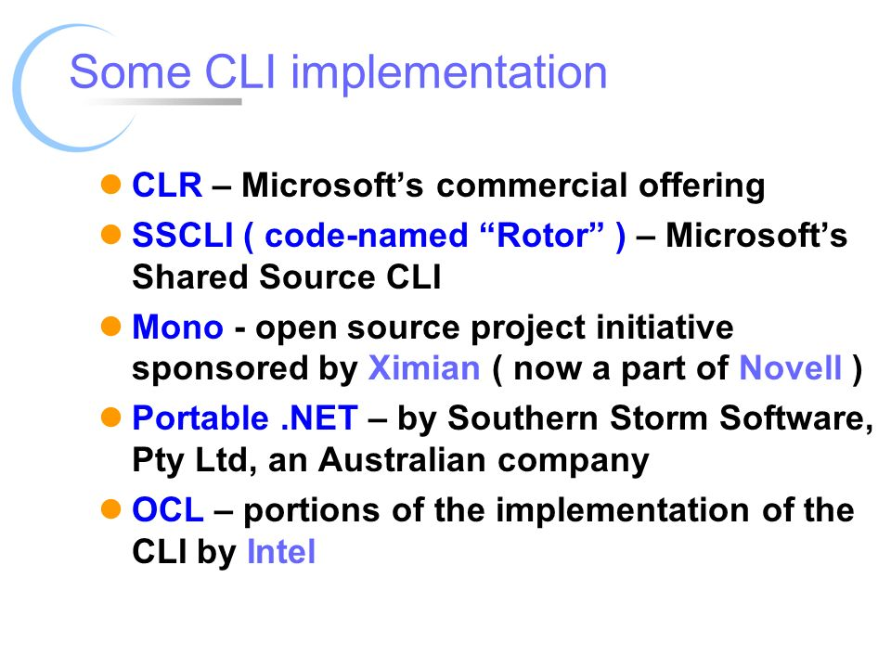
History
http://slideplayer.com/slide/7654501/25/images/16/Some+CLI+implementation.jpg
Notes:
Apparently, from this old slide, there were other runtimes created, but the only ones that survived to 2018 were the CLR and Mono.

Slide 17
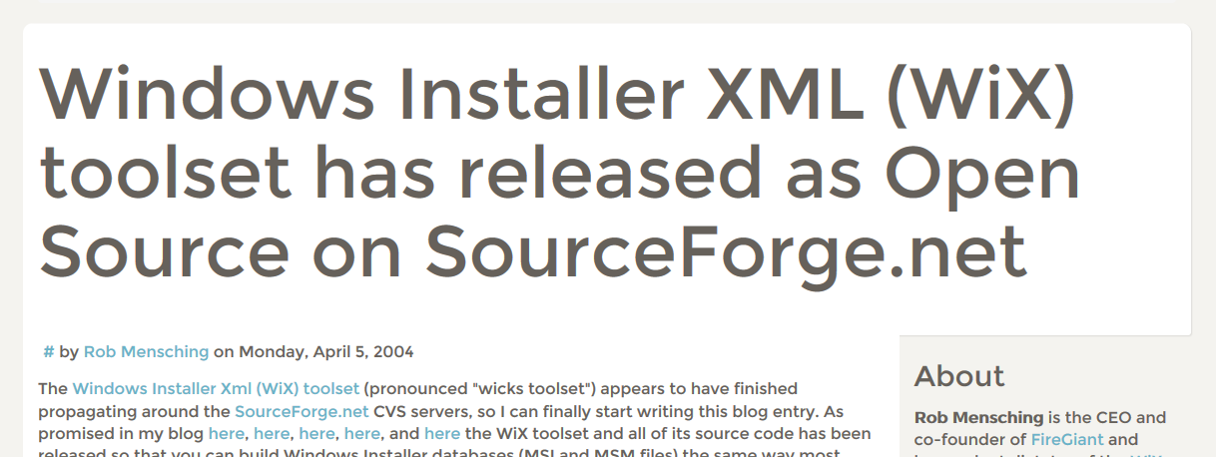
History
https://luauf.com/wp-content/uploads/2008/05/mono-logo.png
Notes:
Interestingly enough, WiX was the first set of code .NET-related from Microsoft that was released as open source.

Slide 18

History
http://itvoir.com/wp-content/uploads/2017/04/01-8.jpg
Notes:
CodePlex was a site released in 2006 from Microsoft that hosted code projects for free, using a number of source control systems, like Git, TFS, Mercurial, and others. (in 2017 it was decided that the site would be shut down and put into read-only mode).

Slide 19
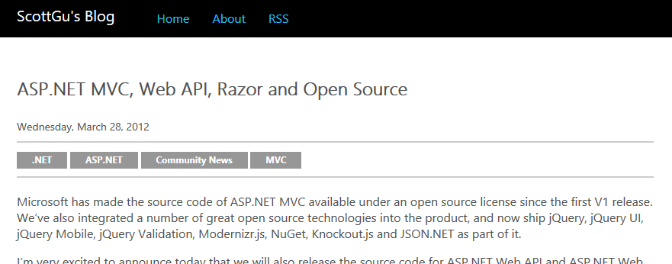
History
https://weblogs.asp.net/scottgu/asp-net-mvc-web-api-razor-and-open-source
Notes:
One of biggest projects that was open-sourced was ASP.NET MVC, which happened in 2012.

Slide 20

History
https://github.com/dotnet/swag/blob/master/roslyn/roslyn_kuhlenh.png
Notes:
Somewhere around 2005 and 2006, another major internal project within Microsoft was brewing: Project Roslyn. The idea was to change the compilers so they were completely managed and had an accessible API for developer so they could take advantage of its capabilities.

Slide 21
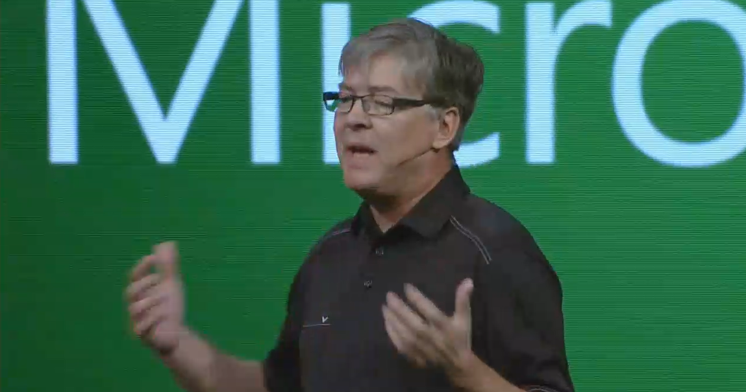
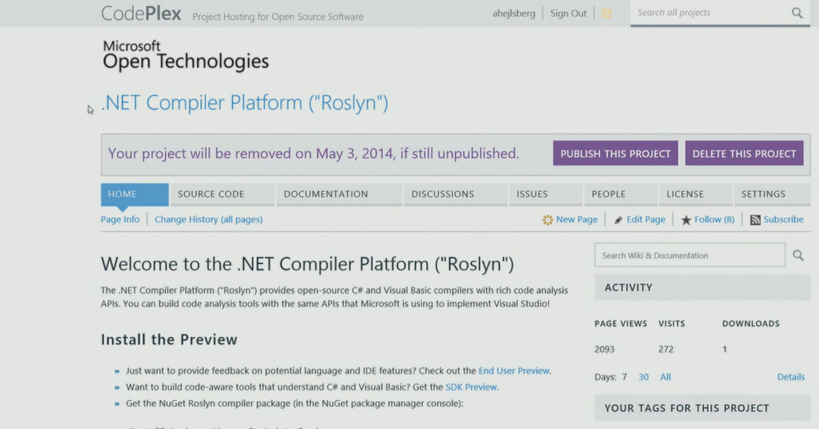
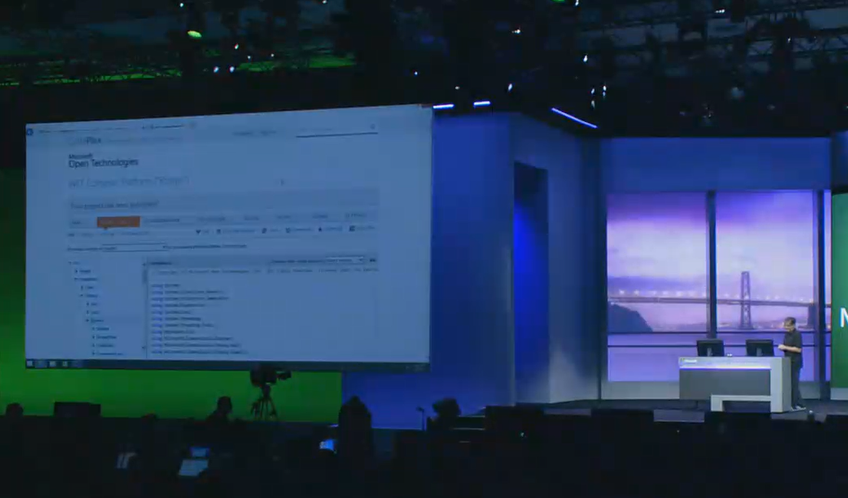
History
https://channel9.msdn.com/Events/Build/2014/KEY02
Notes:
One of the biggest announcements around open source at Microsoft was around Project Roslyn. At Build 2014, they announced live that they were going to release the compiler as open source. This effectively made the underlying core components of .NET OSS. This really opened the floodgates.
Start watching at 1:14:30 – it’s worth it ☺

Slide 22

History
http://dotnetfoundation.org/images/logo_big.png
Notes:
Interestingly enough, right after the Roslyn announcement, the .NET Foundation was announced.

Slide 23

History
https://raw.githubusercontent.com/NuGet/Home/dev/resources/nuget.png
Notes:
With so much open source out there, managing these packages could be difficult, but NuGet has (after some false starts) become the standard .NET package manager.

Slide 24
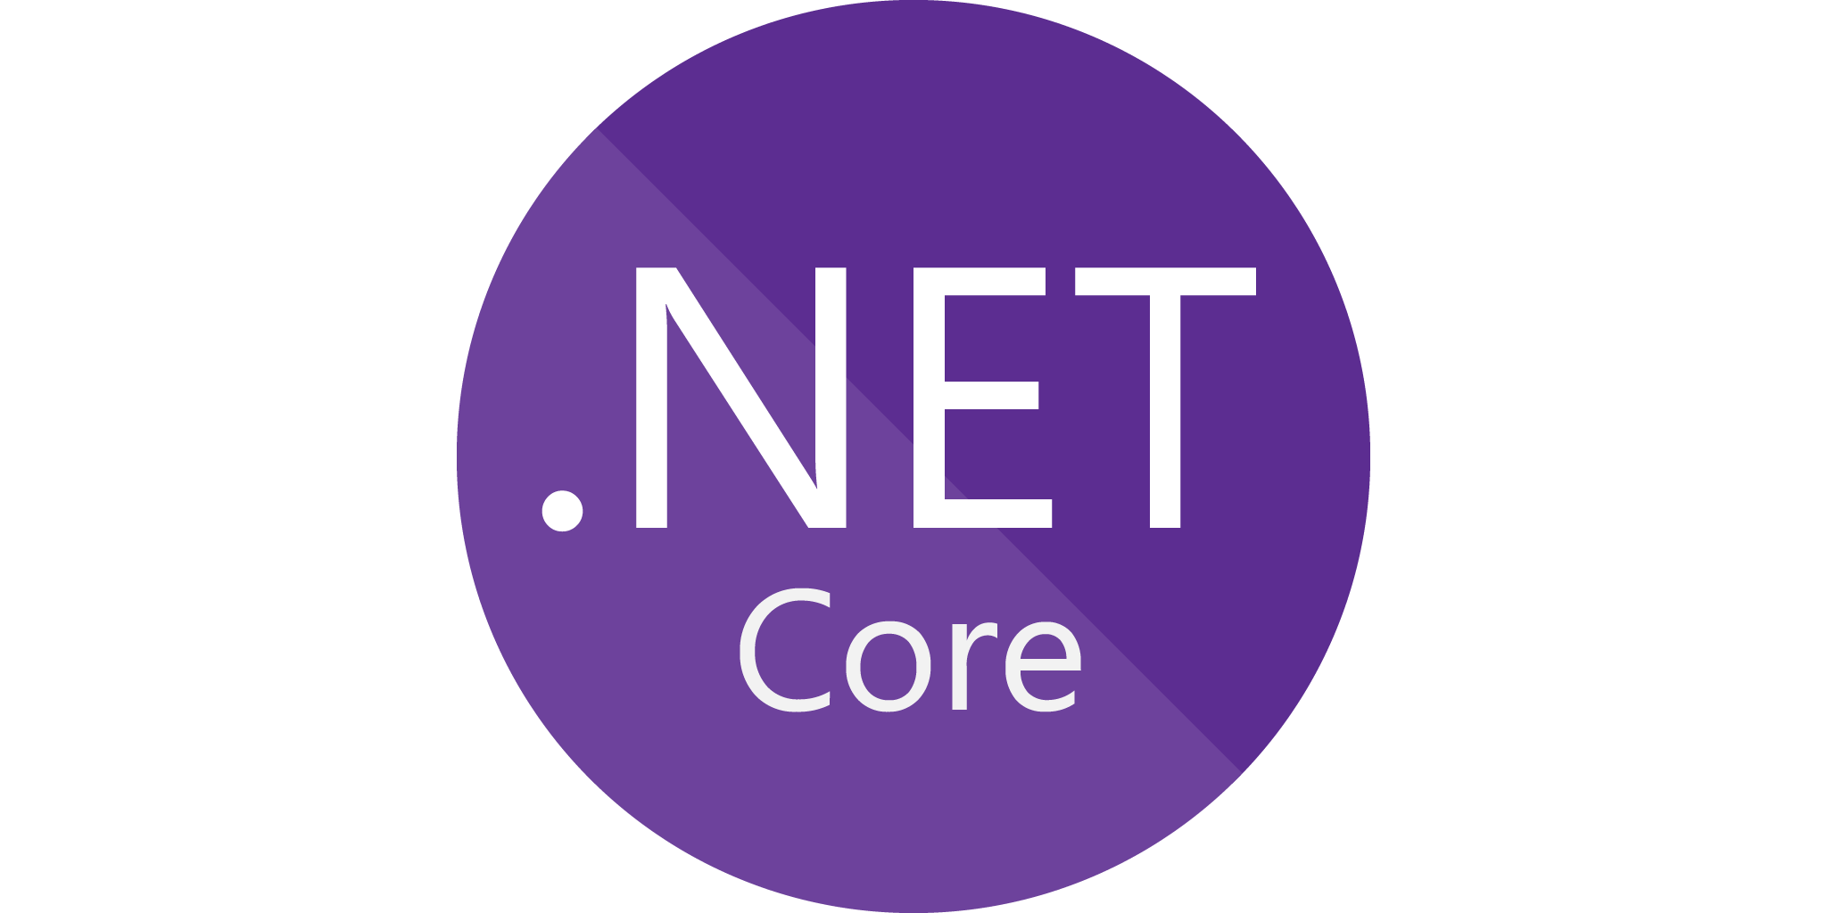
History
https://raw.githubusercontent.com/NuGet/Home/dev/resources/nuget.png
https://github.com/dotnet/core/blob/master/release-notes/2.1/2.1-supported-os.md
Notes:
And finally, with everything going open-source, cross-platform has become a reality with .NET Core. Windows, Mac and Linux.

Slide 25







Demo
Notes:
So what’s it like to write .NET in an open source world? Let’s do a simple example….

Slide 26
Demo: Writing C# Code Using Open-Source Tools and Packages
The State of OSS and .NET
Notes:
Let’s see how .editorconfig can affect code styles, and what happens when you add analyzers to a project and what they can find.

Slide 27

Future Trends
https://dialectline.files.wordpress.com/2012/04/crystal_ball1.jpg
Notes:
So, where are things going to go from here? It’s obvious to me that .NET is OSS and will remain so. That isn’t going away.

Slide 28
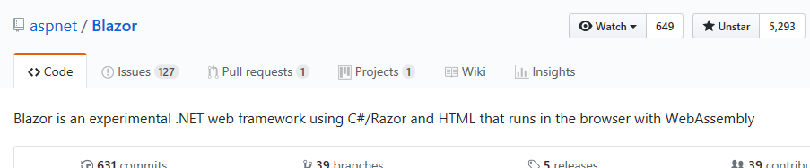
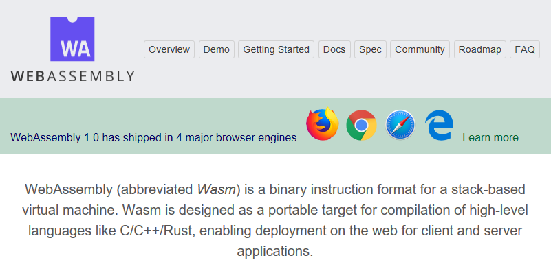
Future Trends
https://webassembly.org/
https://github.com/aspnet/Blazor
Notes:
There’s more positive stuff, like Blazor, which is an experimental version of .NET that runs in the browser, via a version of Mono that targets WebAssembly.

Slide 29
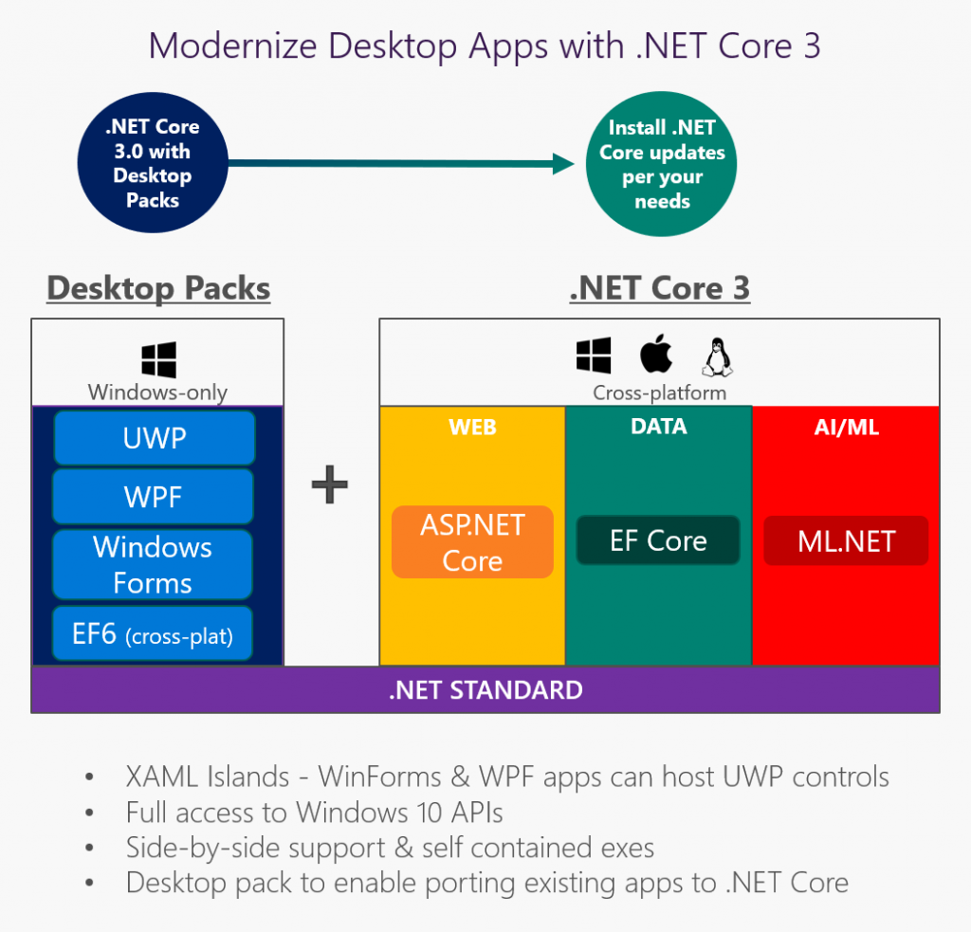
Future Trends
https://blogs.msdn.microsoft.com/dotnet/2018/05/07/net-core-3-and-support-for-windows-desktop-applications/
Notes:
And then there’s this….”Desktop Packs” for .NET Core 3?! What madness is this?

Slide 30

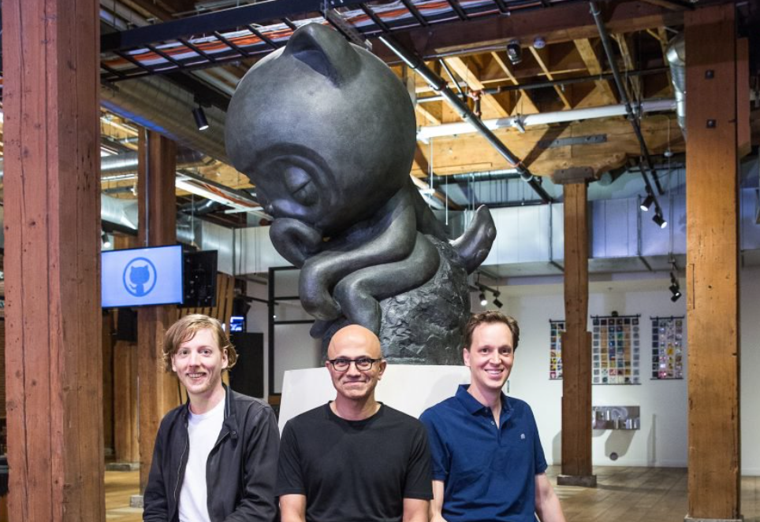
Future Trends
https://news.microsoft.com/2018/06/04/microsoft-to-acquire-github-for-7-5-billion/
Notes:
Then there’s this….some people think this is the worth thing for GitHub, OSS, and life on earth in general. Others don’t have issues with it.

Slide 31
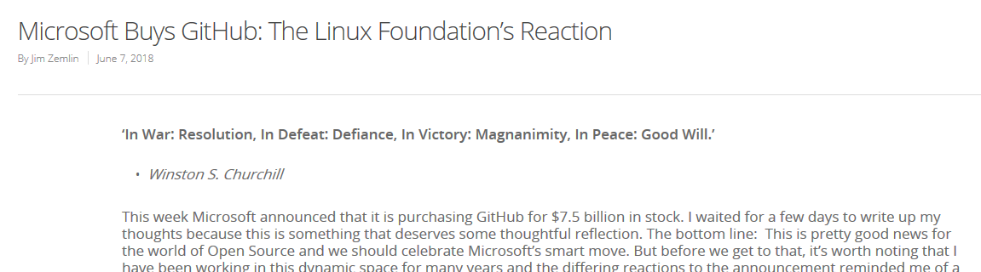
Future Trends
“But times have changed and it’s time to recognize that we have all grown up – the industry, the open source community, even me.”
https://www.linuxfoundation.org/blog/microsoft-buys-github-the-linux-foundations-reaction/
Notes:
I personally find this write-up rather striking and insightful.

Slide 32
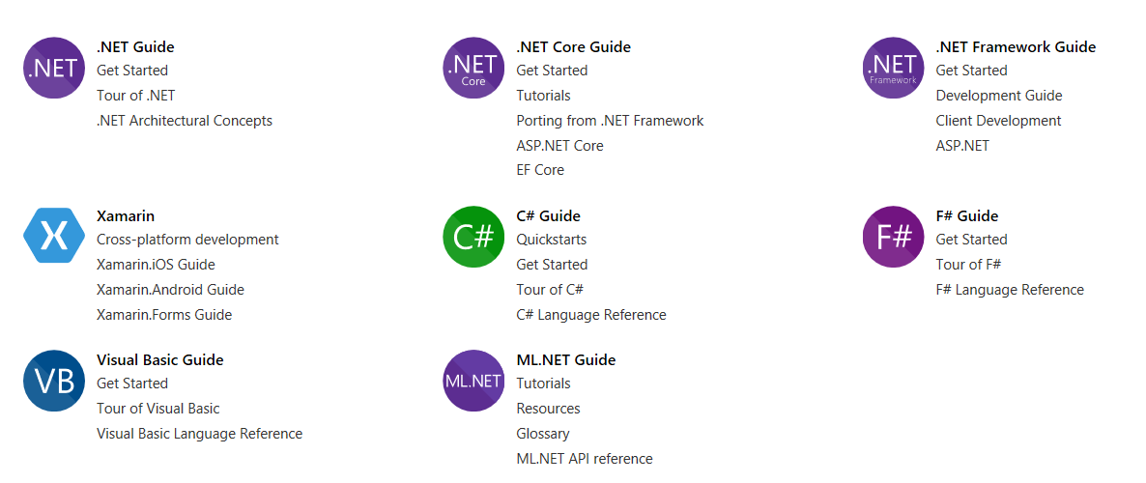
Future Trends
https://docs.microsoft.com/en-us/dotnet/#pivot=docs&panel=getstarted
Notes:
But notice something on the docs.microsoft.com site…. ML.NET? Oh yes, machine learning + .NET is a thing ☺

Slide 33
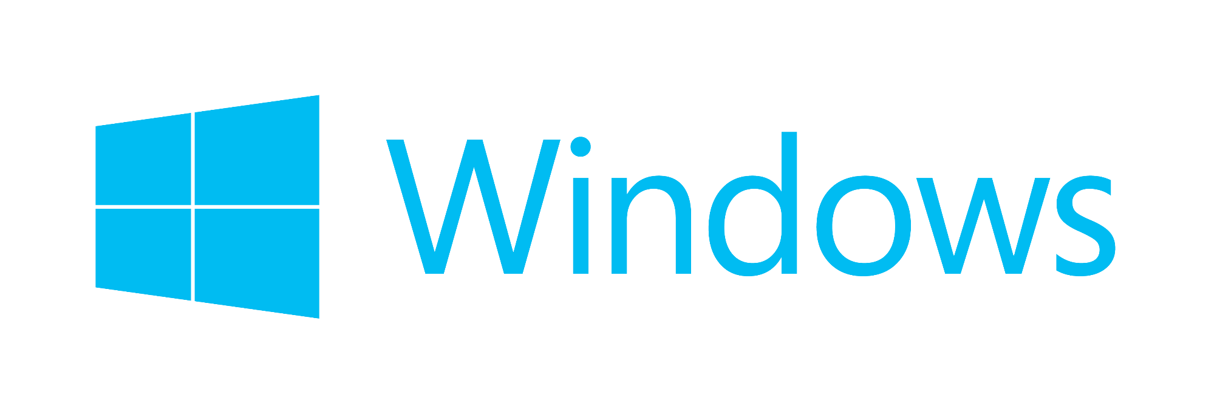

Future Trends
http://logok.org/wp-content/uploads/2014/12/Windows-logo-2012.png
http://static.itpro.co.uk/sites/itpro/files/office365logoorange_web.png
Notes:
To me, though, the big question for Microsoft as it pertains to OSS is….will Windows go OSS? Or what about Office?

Slide 34

Future Trends
http://3.bp.blogspot.com/_a-EWAFOFy3k/TO5vCC2cvaI/AAAAAAAABmc/txDwUuPy3ZM/s1600/A+Ponte.jpg
Notes:
Also, from a dev perspective, I think the .NET community, especially within companies, needs to do better to support OSS.

Slide 35
The State of OSS and .NET
Jason Bock
Practice Lead

